Slide 1
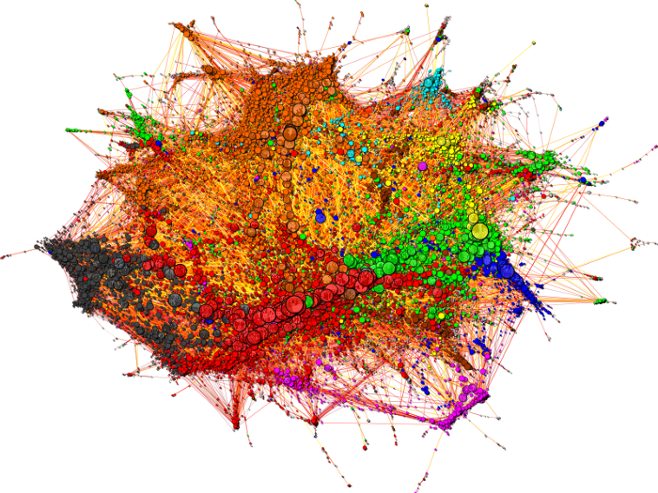
The magic world of
Graph ML

Slide 2
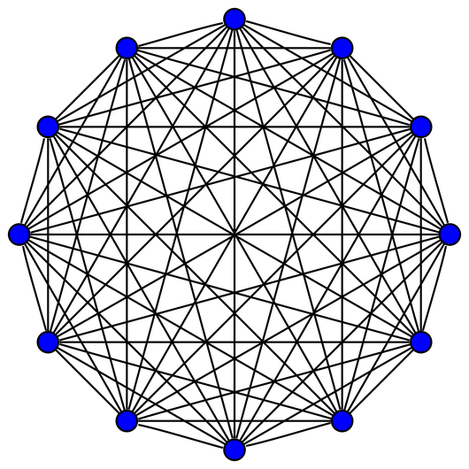
What are graphs?
Nodes
Edges

Slide 3
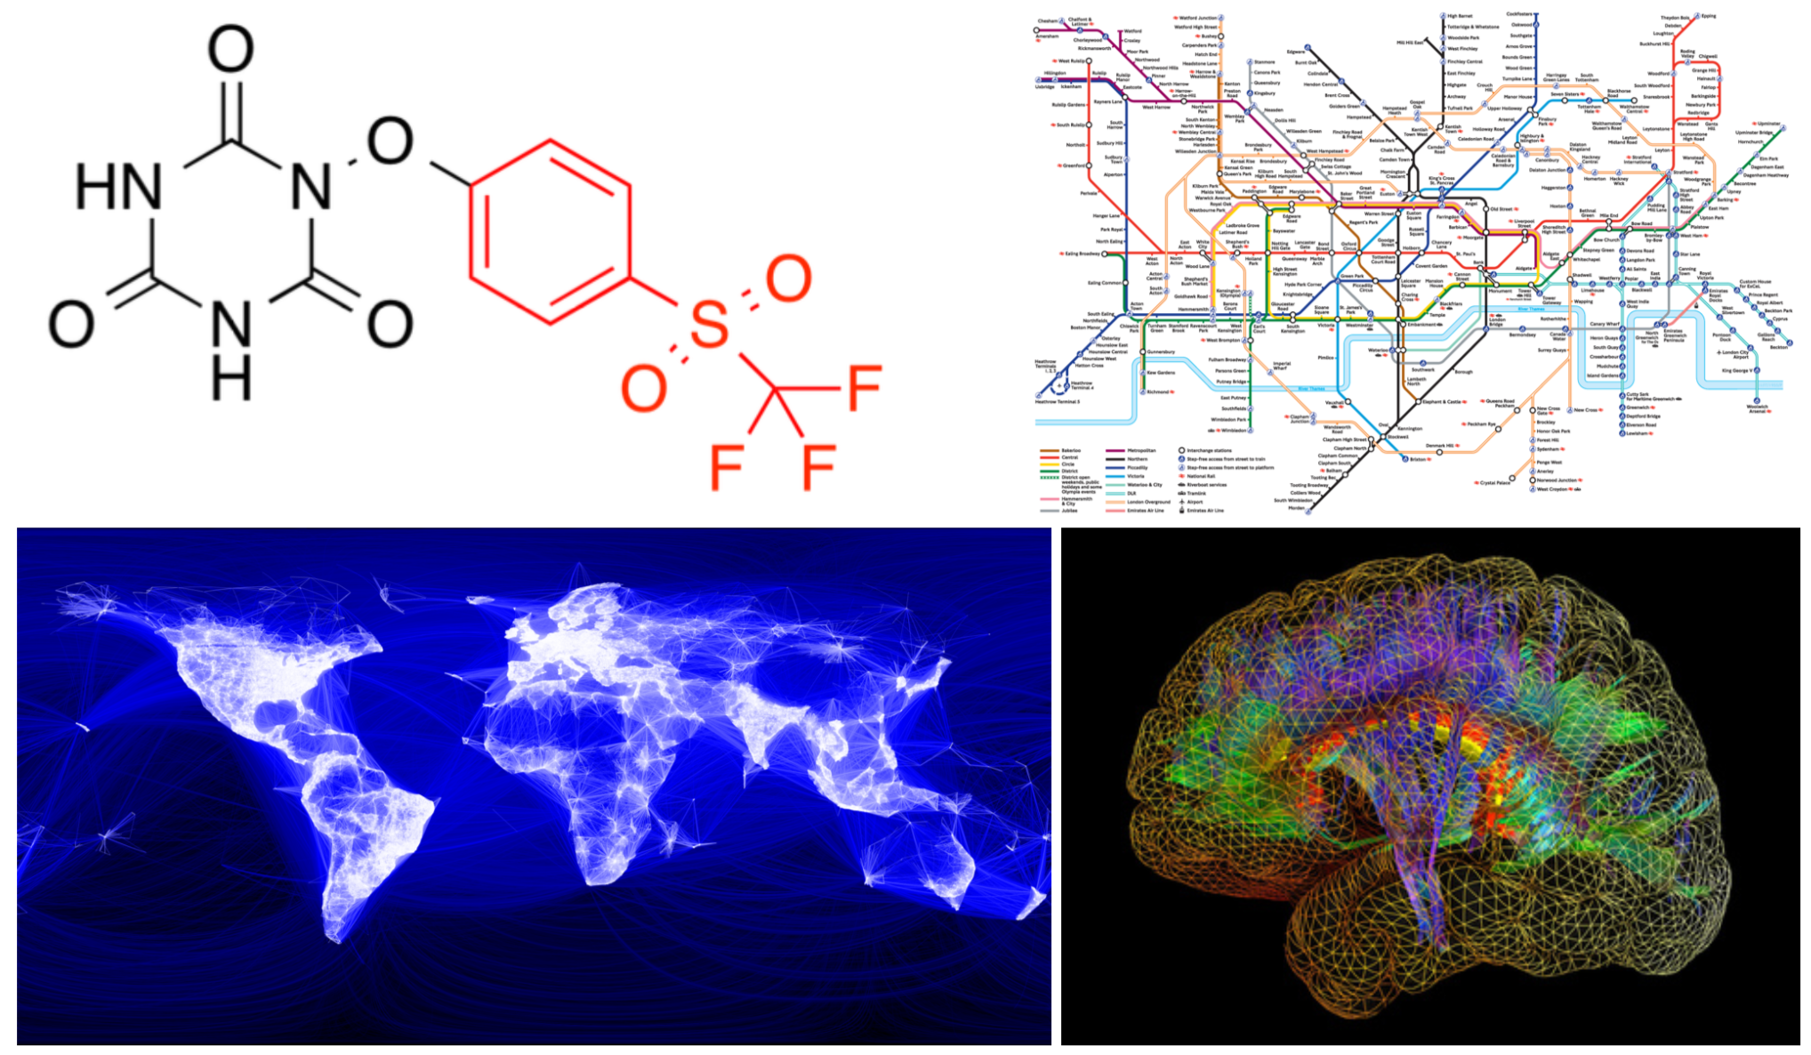

Slide 4
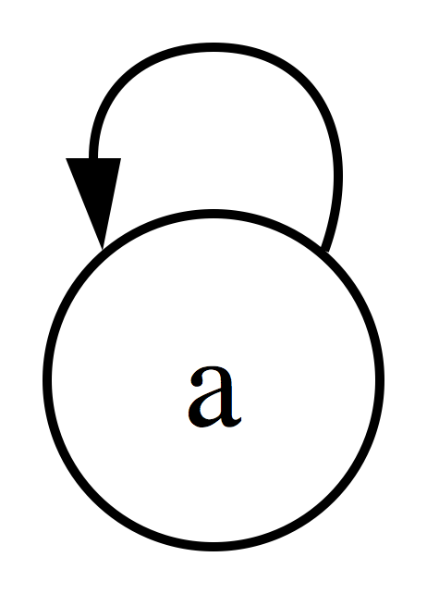
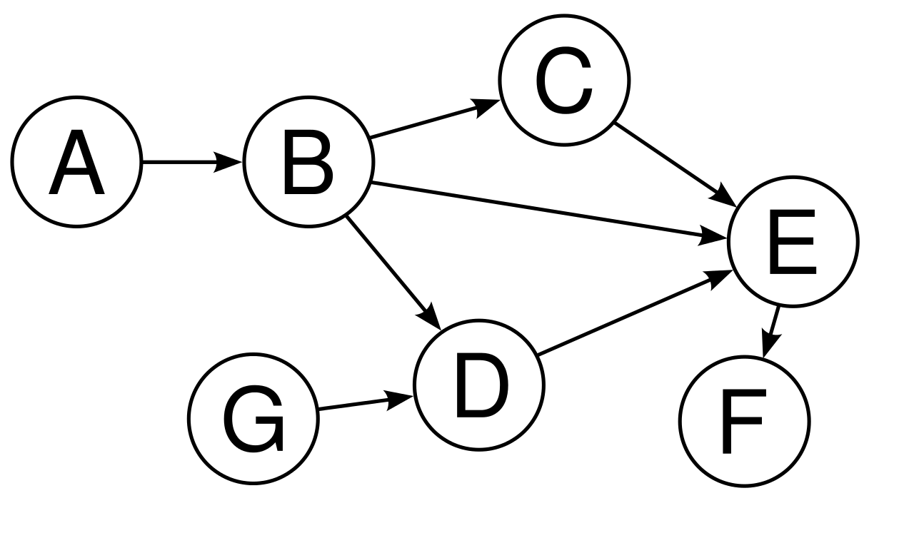
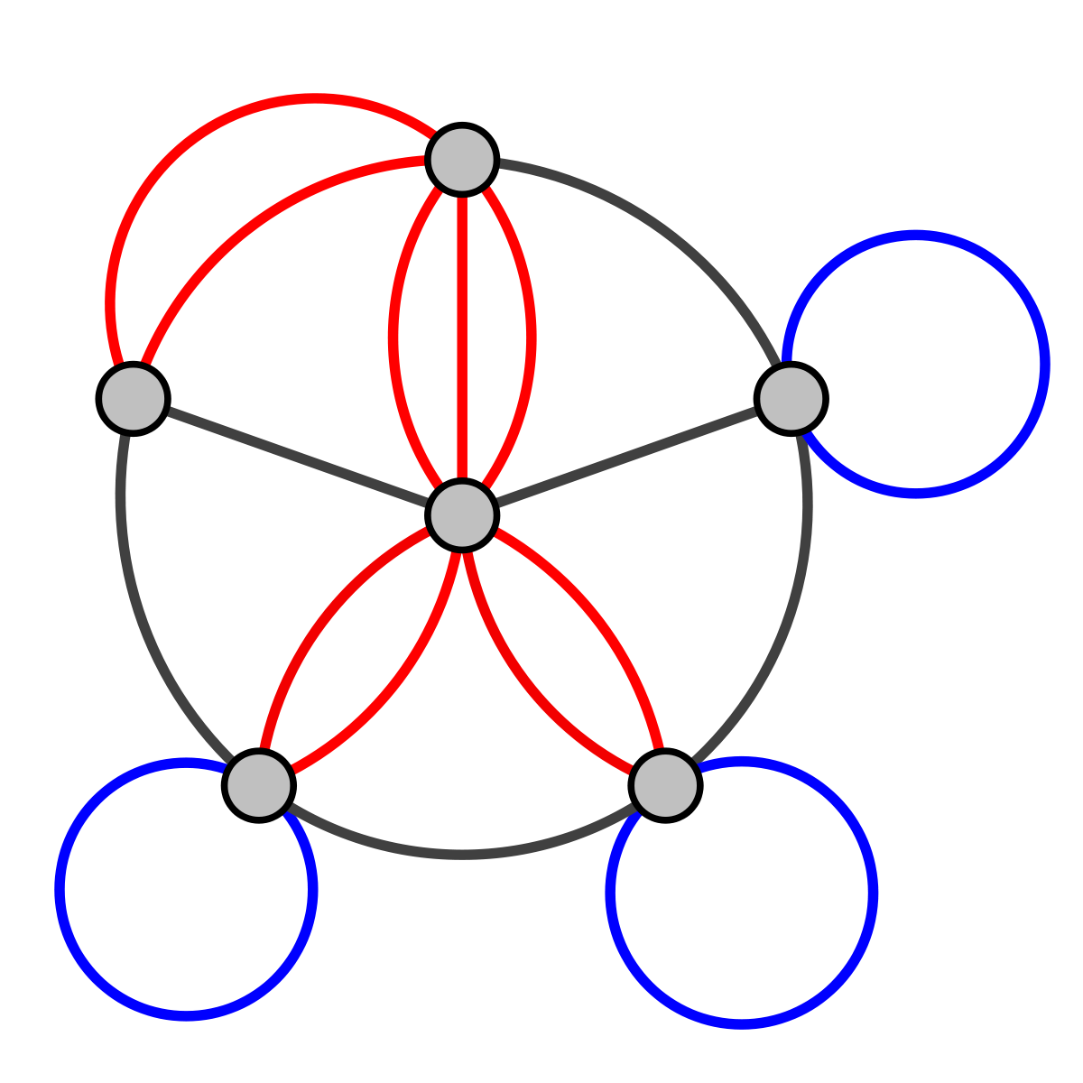
50 shades of graphs
Simplifying assumption:
Undirected
Self-edges

Slide 5
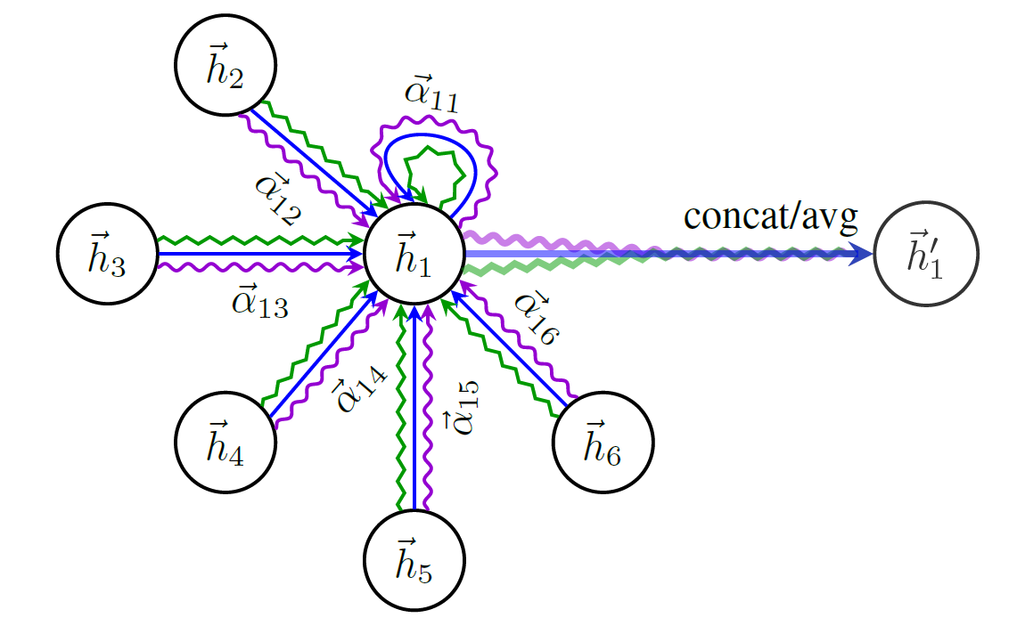
What we care about: features
Classic node features example: Cora
Vocab
Is word present in this paper/node?
Edge features example: molecules

Slide 6
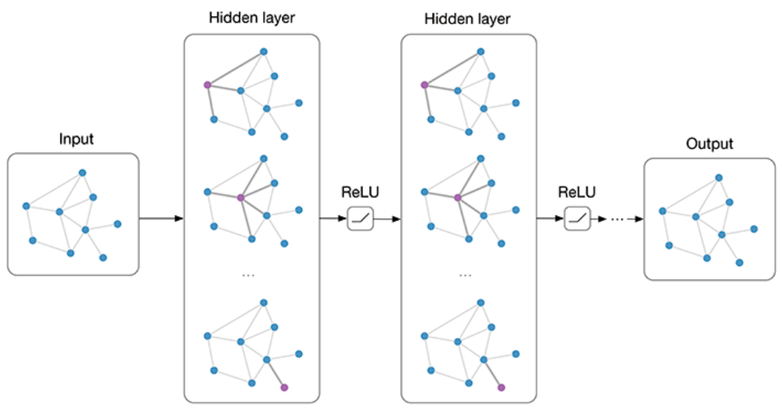
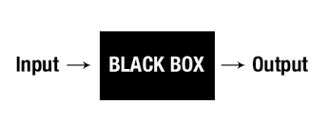
Graph Neural Networks (GNNs)
Abstract applications:
Graph classification/regression
Node/edge classification/regression

Slide 7
Graph ML - applications

Slide 8
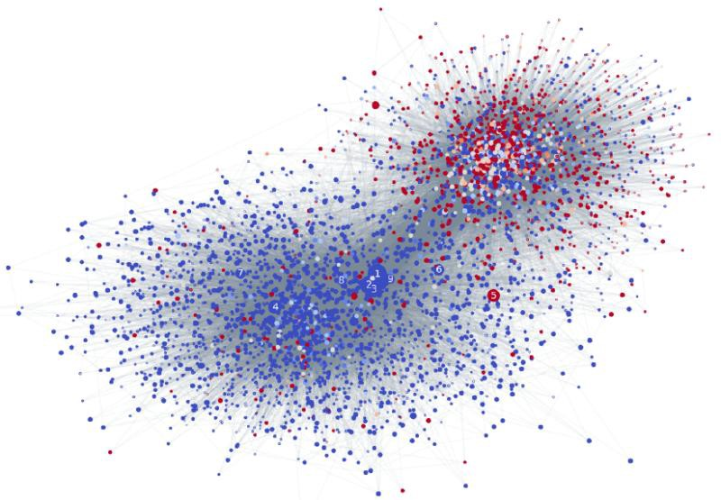
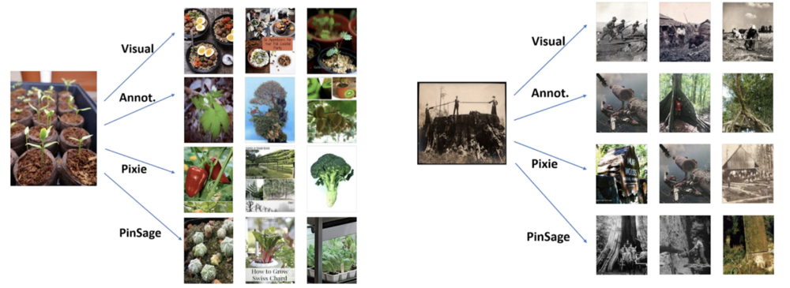
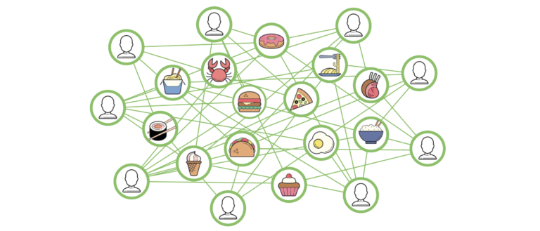
Graph ML apps

Slide 9
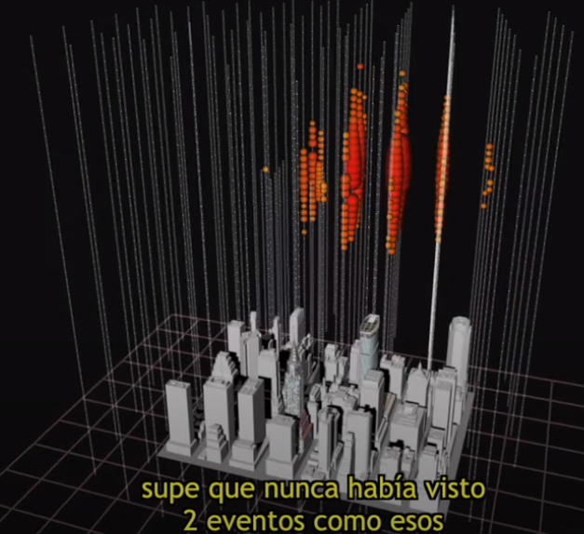
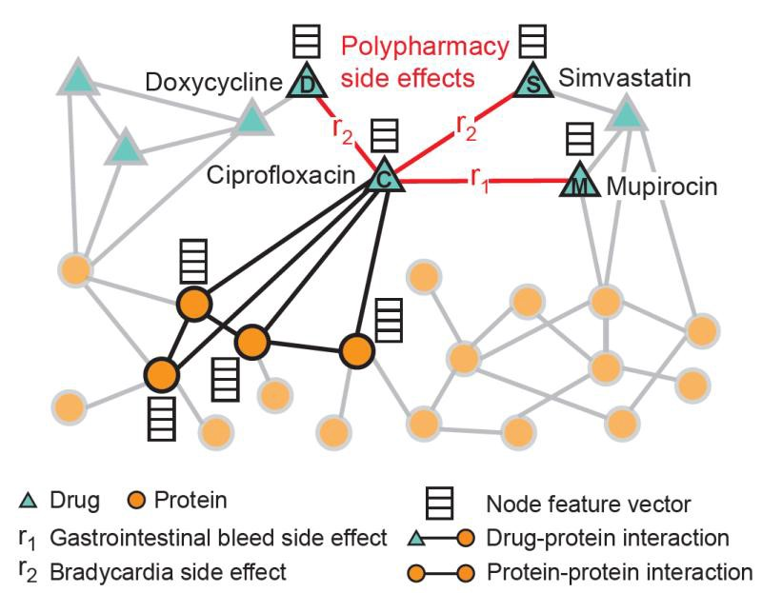
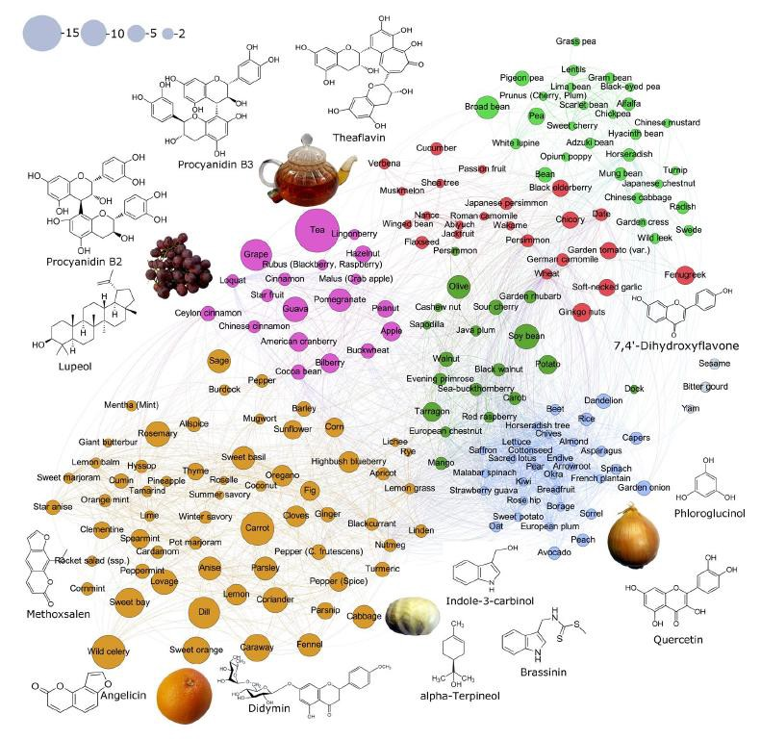
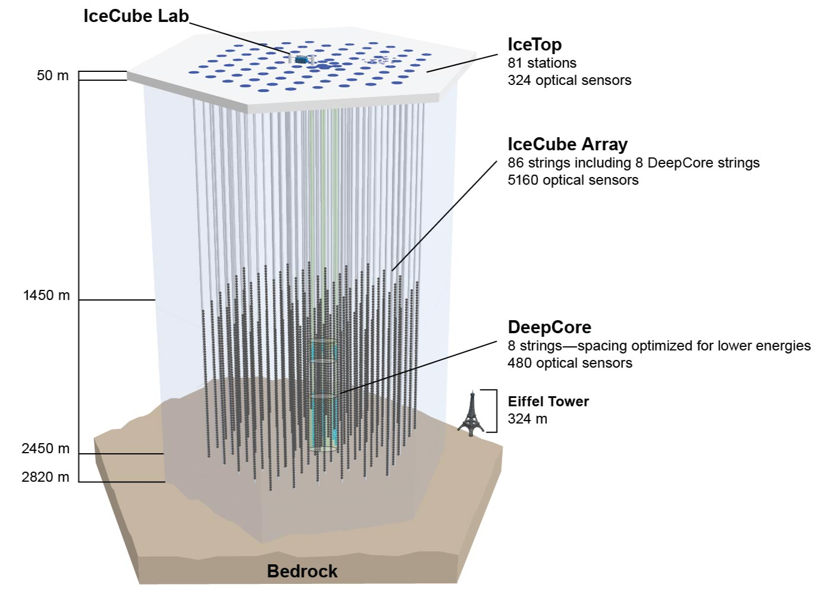
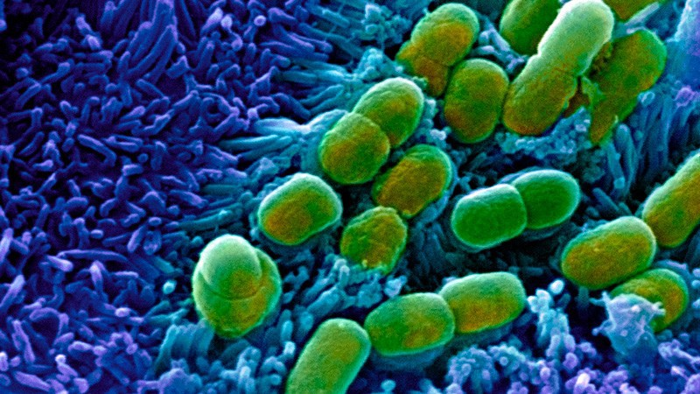
Graph ML apps – fundamental science

Slide 10
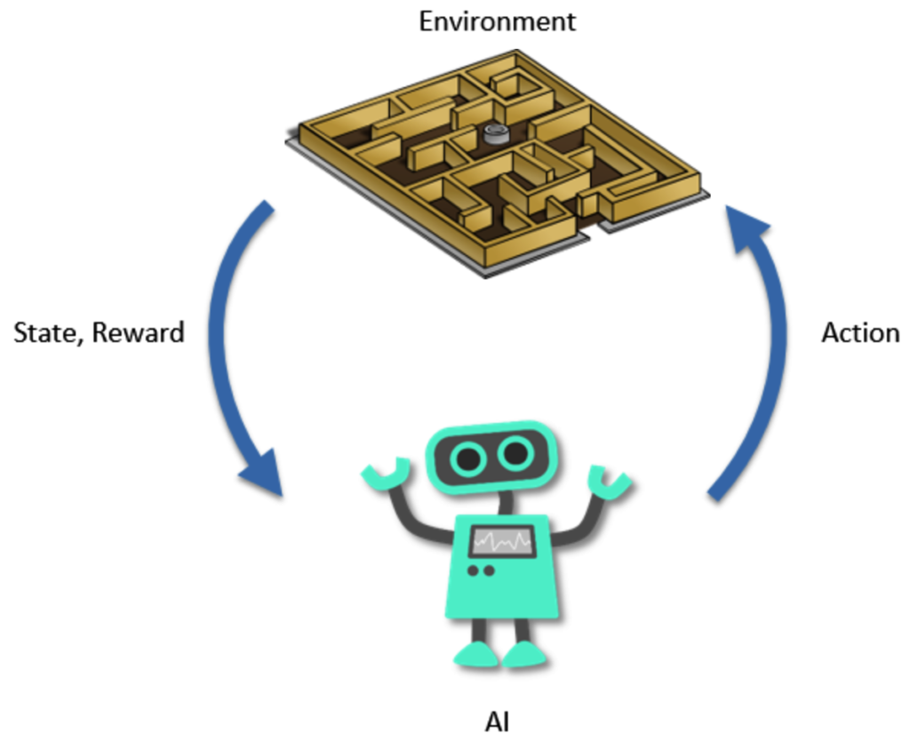
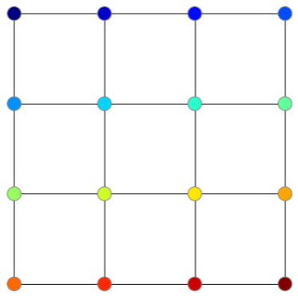
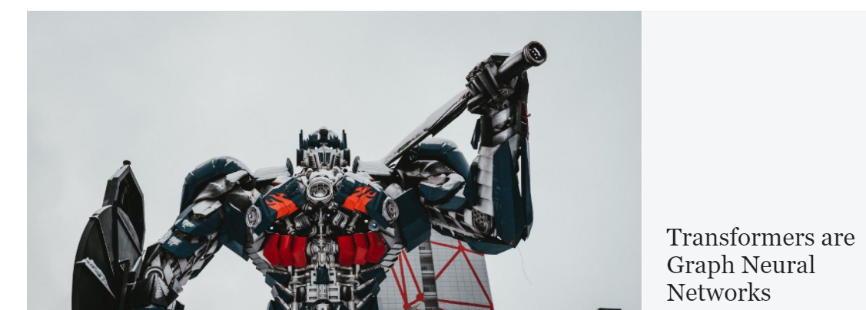
Contrasting Graph ML with CV, NLP, RL

Slide 11
Graph ML – high level survey

Slide 12
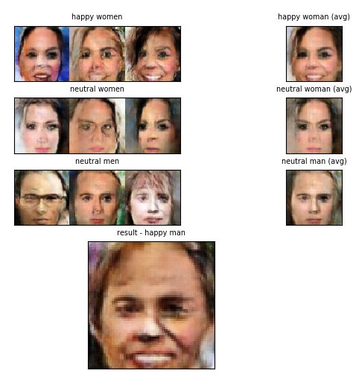
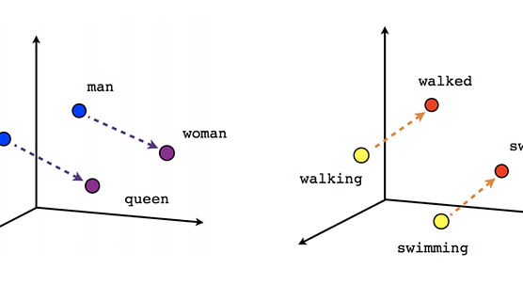
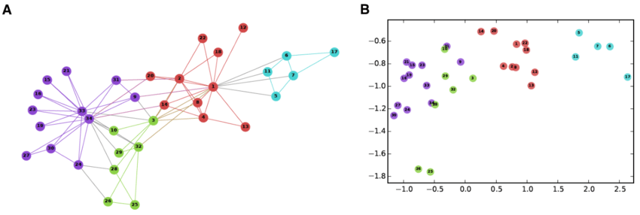
Graph embedding methods
DeepWalk, Node2Vec, etc.

Slide 13
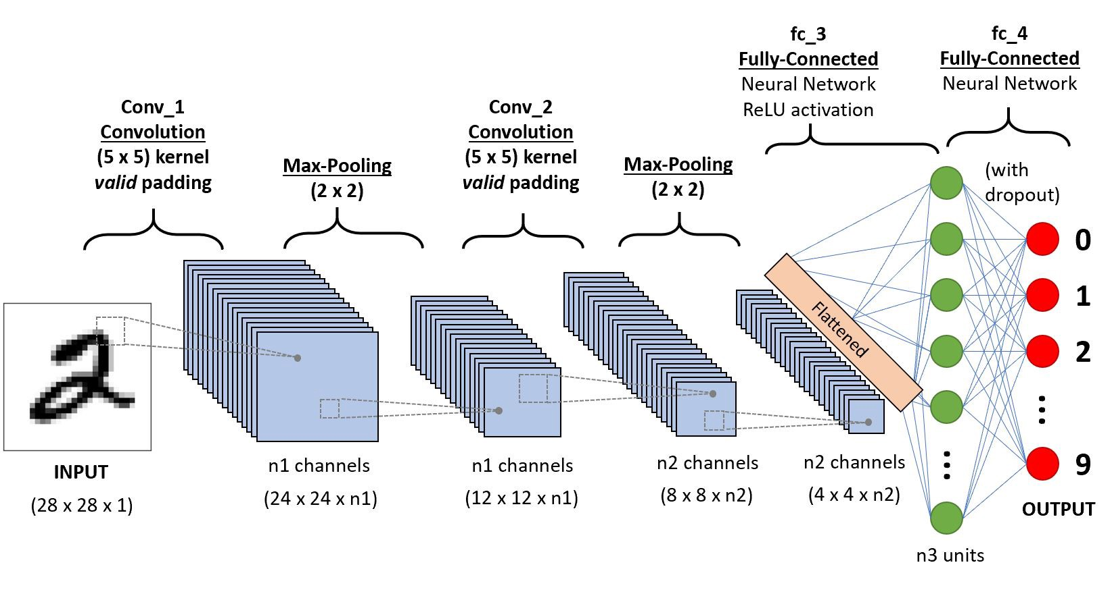
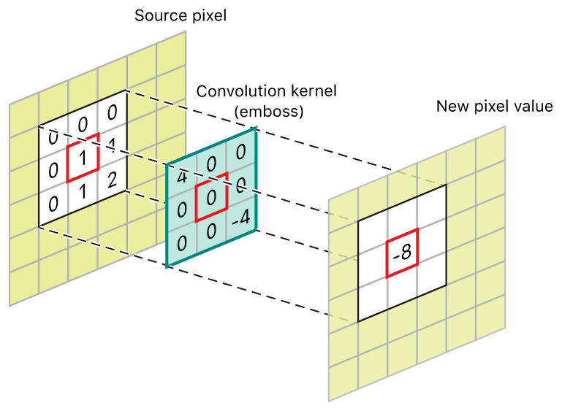
Convolution (on the way from CV to Graph ML)

Slide 14
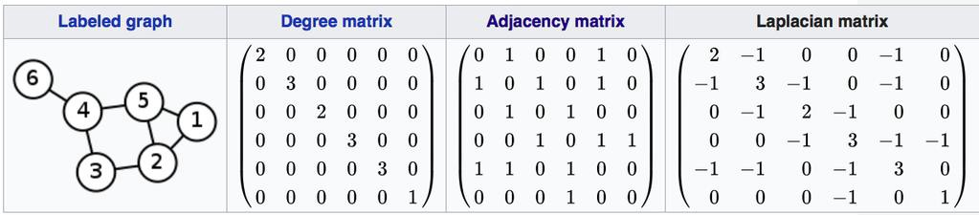
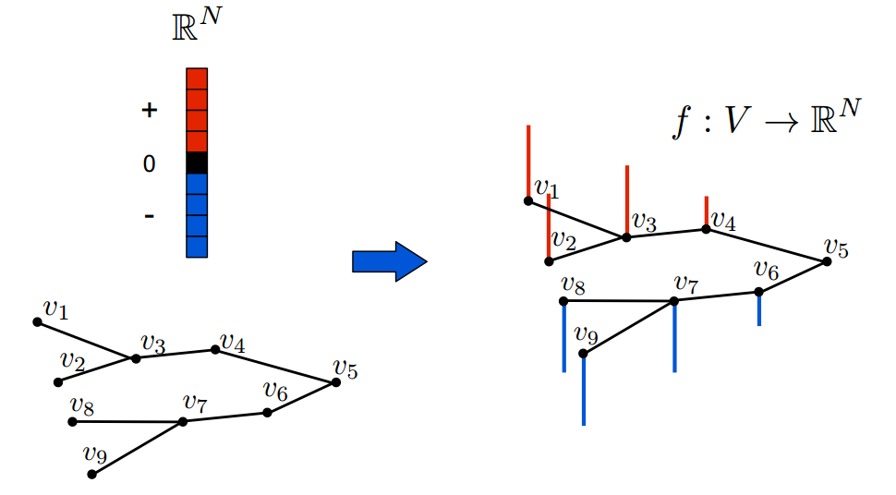
Adjacency matrix, Laplacian, signals

Slide 15
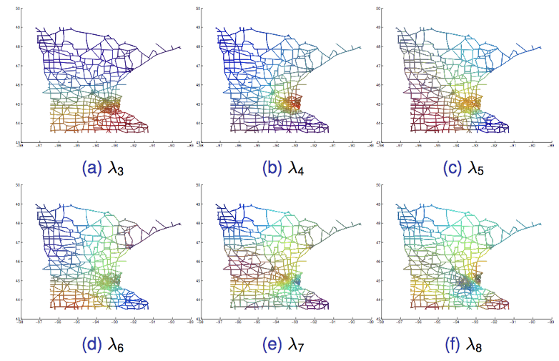
GNNs – spectral methods
Pros:
Mathematical notion of convolution
Cons:
Computationally expensive ~O(n³)
Inherently transductive
Chebnets:
k-hop, faster

Slide 16
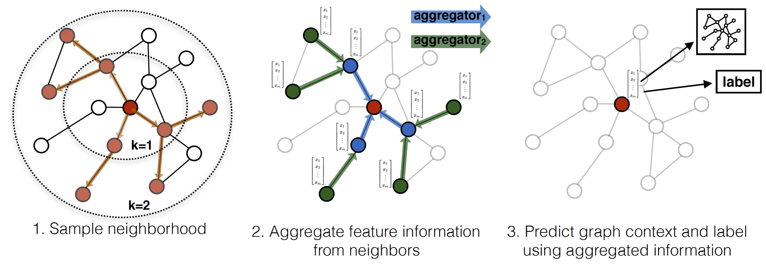
Spatial GNNs

Slide 17
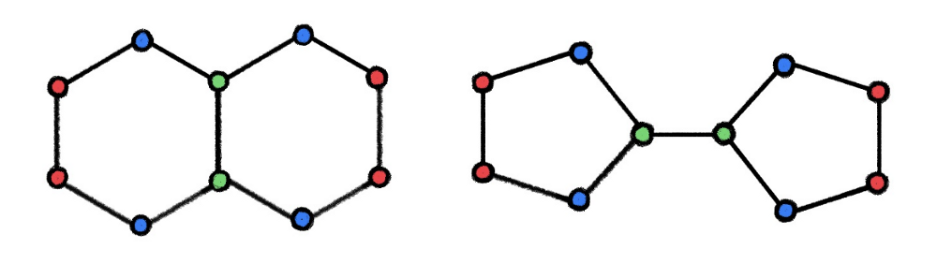
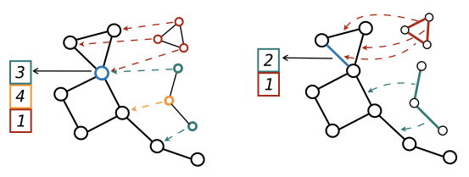
GNN expressivity (going beyond WL)
Are these graphs the same?
One solution: counting subgraphs
More expressive -> better for your problem? No.

Slide 18
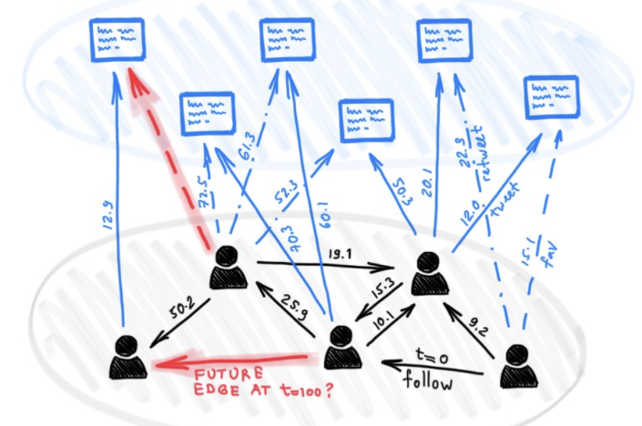


Dynamic graphs
Representing time as a vector
Temporal neighborhood

Slide 19
GAT project

Slide 20
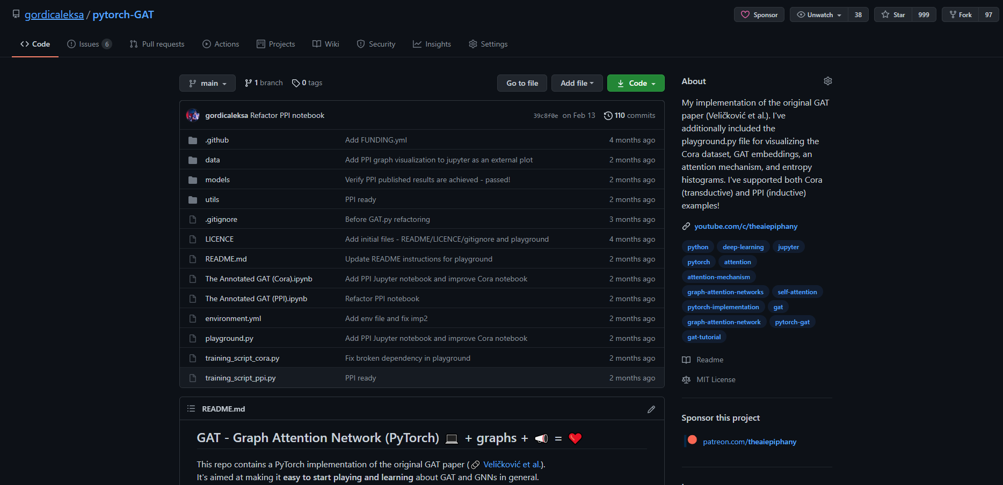
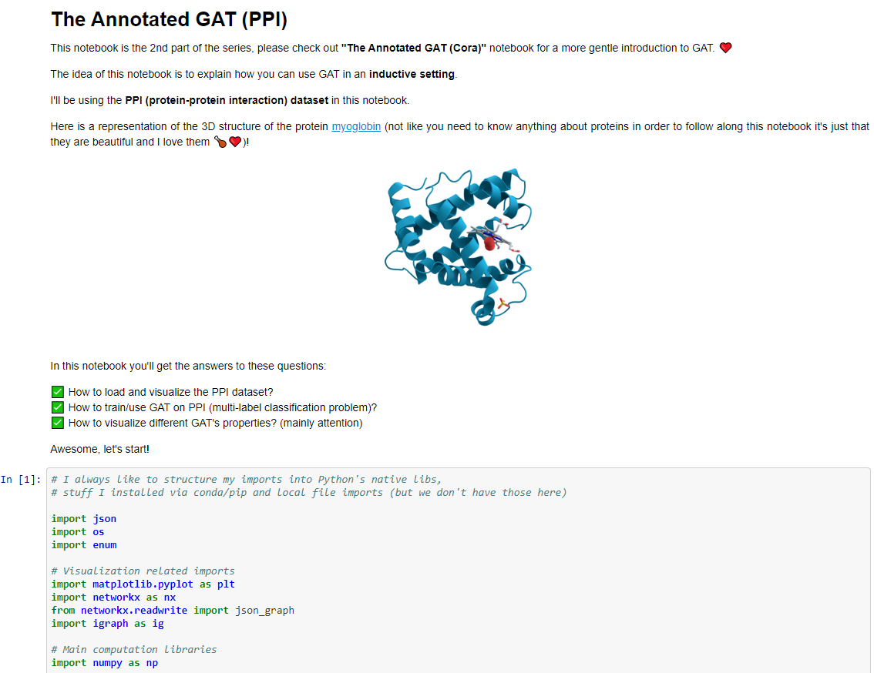
GAT – Graph Attention Network project

Slide 21
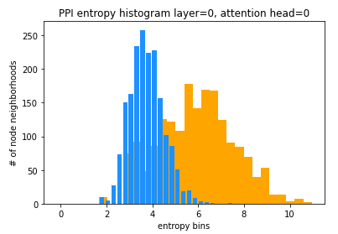
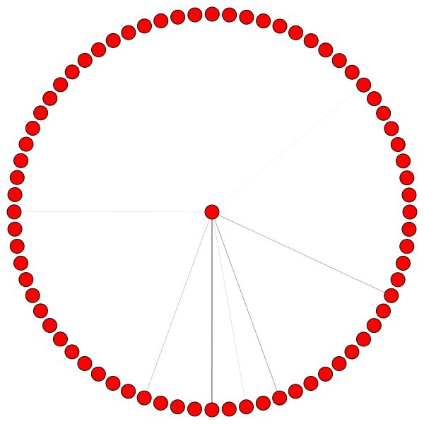
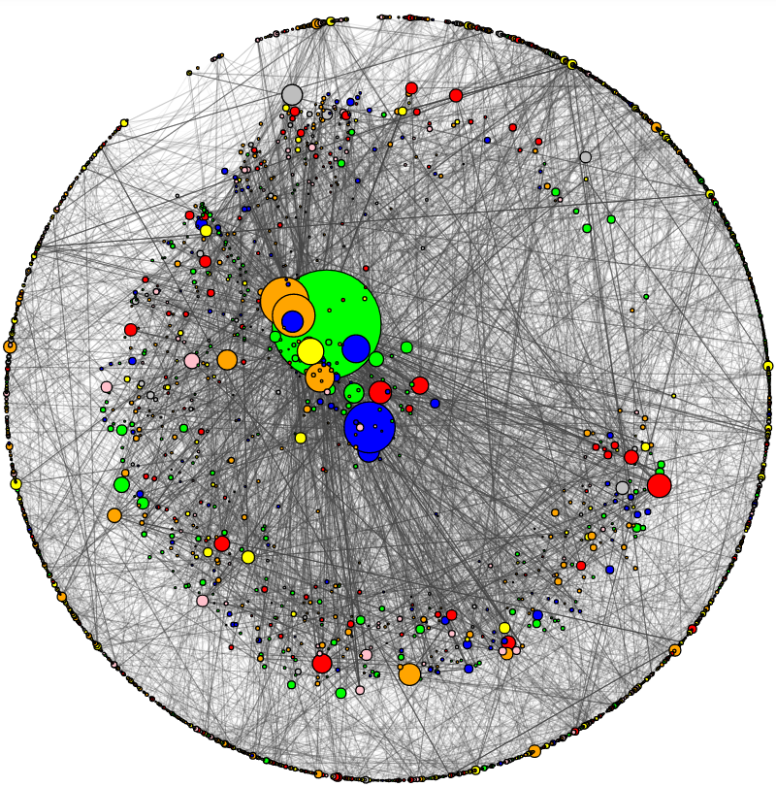
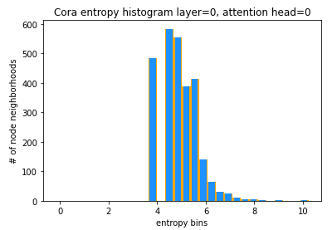
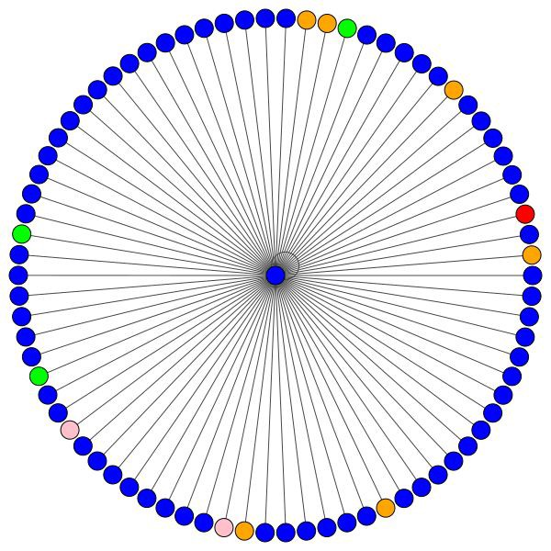
Graph Attention Network (GAT) project

Slide 22
Further learning resources for Graph ML:
https://github.com/gordicaleksa/pytorch-GAT (Graph Attention Net)
https://www.youtube.com/c/TheAIEpiphany (lots of Graph ML vids)
https://gordicaleksa.medium.com/how-to-get-started-with-graph-machine-learning-afa53f6f963a (getting started with Graph ML)

